Slide 1
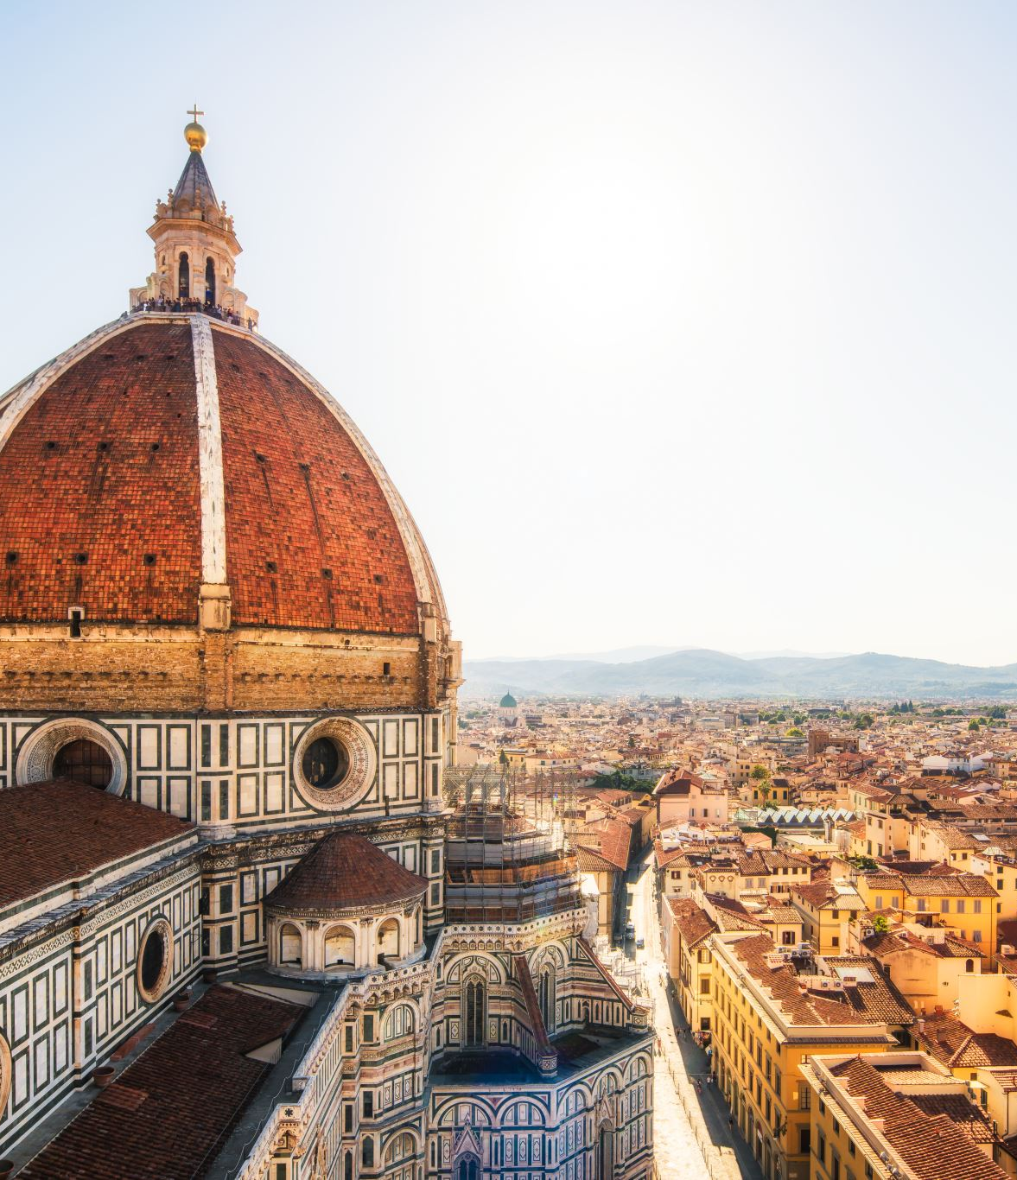
Saint Rita of Cascia

Slide 2
Background – Catholic Church at the Time
During the 15th century Italy was going through a renaissance and there were many artists such as Michelangelo and Leonardo da Vinci who were receiving funding from the church at the time.
At the time the church had immense wealth and political power.
The church funded ministries, which housed nuns and brothers.

Slide 3
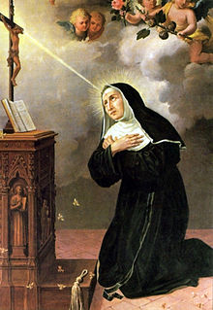
Saint Rita Life Story
Born 15th Centaury
Swarmed by friendly bees the day after her baptism
Wanted to be a nun at a young age
Arranged marriage at 12 to Paolo Mancini
Paolo was a bad person and was in a feud with another family
Rita had two children

Slide 4
Saint Rita Life Story - Continued
Rita helped Paolo become a better person
Paolo got betrayed and got killed by one of his allies
Rita’s children wanted to avenge their father
Rita tried to stop them
A year later the children died

Slide 5
Saint Rita Life Story - Continued
She tried and was denied trying to become a nun
They said that she must end the family’s feud before she could enter
Paolo’s brother died of the bubonic plague and the feud ended
She then joined the monastery at age 36 and spent the rest of her life as a nun

Slide 6
Saint Rita’s Values
Modesty
Fortitude - End a family dispute and convert her husband to a better man.
Temperance
Justice – Use Prayer to influence justice around her
Modesty
Persistence - Pursue her goals of becoming a nun when it seemed unlikely

Slide 7
Saint Rita’s time as a Nun
Saint Rita was part of St. Mary Magdalen Monastery in Cascia.
Nuns are devoted to God and take vows of chastity to become closer to God.
They learned, helped the sick and educated others as their nun vocation.
Being a Nun is a priestly vocation as the goal is to become and bring others close to God

Slide 8
Conclusion
In conclusion Saint Rita was a very priestly person, showing many virtues and finding ways to do the impossible. She helped many people in her time of being a nun and was canonized in 1900 by Pope Leo XIII.

